Slide 1
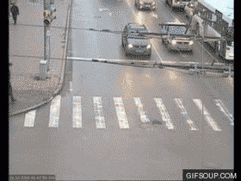

Slide 2
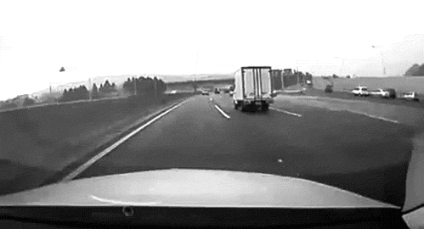

Slide 3
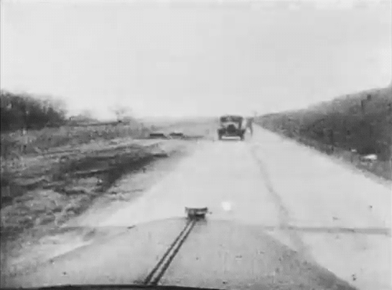

Slide 4
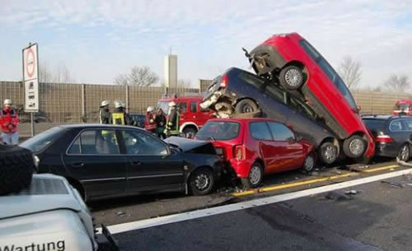
What causes car crashes?
Write down everything you can think of

Slide 5

Break it down:
Human factors
Car or road factors

Slide 6

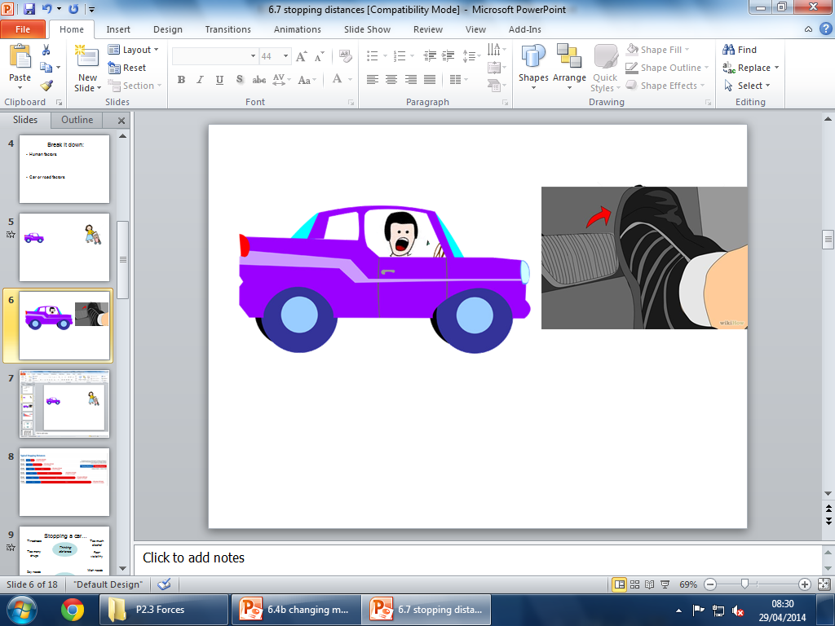
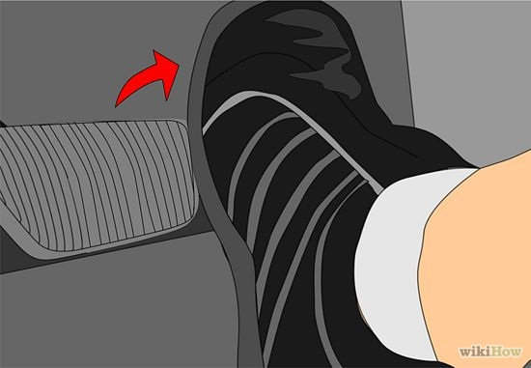
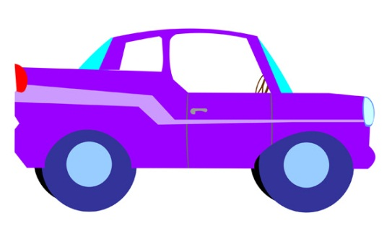


Slide 7
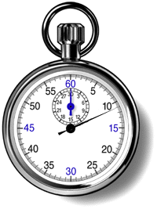

Thinking distance
x
What effects the thinking distance?

Slide 8



Brakes have been applied
What effects the braking distance?
Braking distance

Slide 9
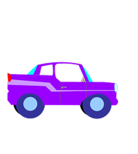

Thinking distance
Braking distance
Stopping distance

Slide 10
Stopping a car…
Tiredness
Too much alcohol
Thinking distance
Too many drugs
Poor visibility
+
Wet roads
Icy roads
Braking distance
Tyres/brakes worn out
Driving too fast

Slide 11
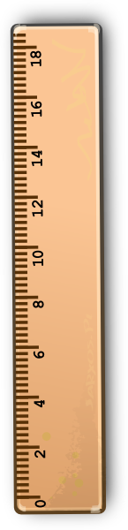

Experiment
Get your partner to drop the ruler vertically.
React and catch it!

Slide 12
Reaction times. What is your reaction time?
Task: Measure it three times and take an average.
 | Reaction time
10cm 20cm 30cm 40cm 50cm | 0.14s 0.20s 0.24s 0.28s 0.31s

Slide 13
Reaction time ___ secs
Speed (mph) | Speed (m/s) | Thinking distance (speed x reaction time)
20 | 8.9
30 | 13.4
40 | 17.8
50 | 22.3
60 | 26.8
70 | 31.2
80 | 35.7
100 | 44.7

Slide 14
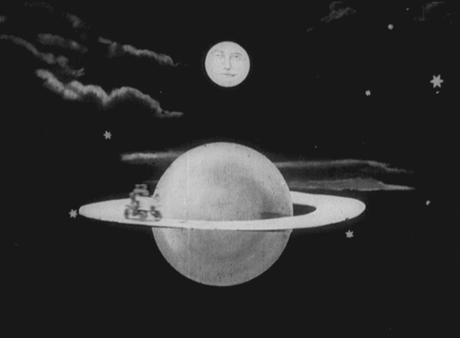
Guess… What is the stopping distance of a car travelling at 70mph? (National speed limit on a motorway)

Slide 15
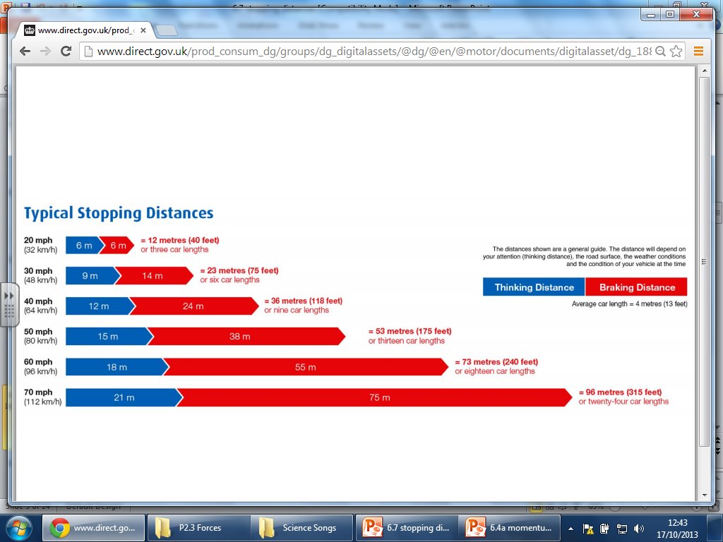

Slide 16
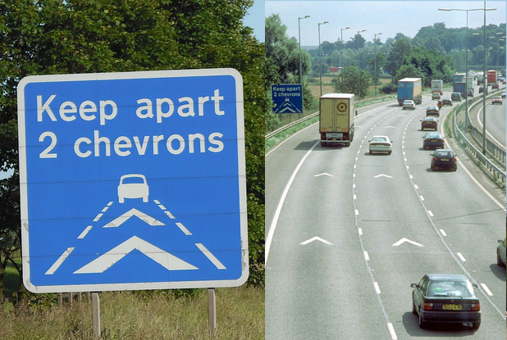

So… why are these the same distance apart in all three lanes?...

Slide 17
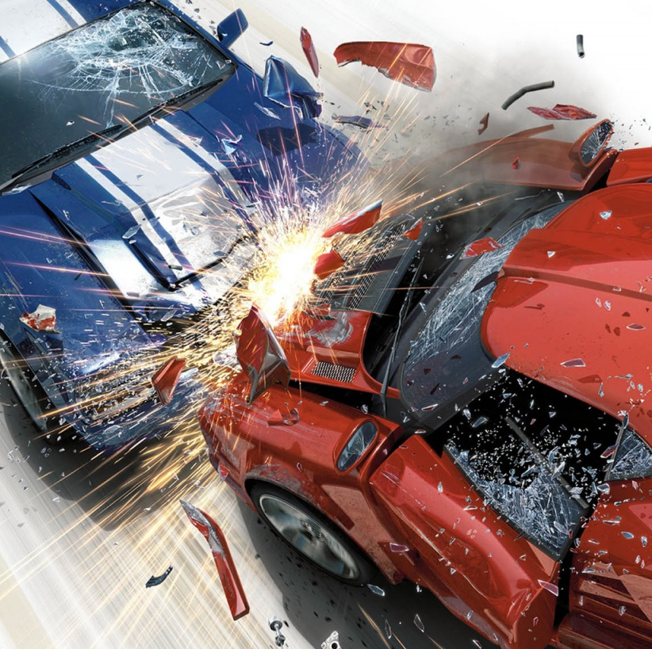
H/w Make a poster outlining the factors that effect cars stopping
Include statistics on distances for different speeds/roads
Break it into two:
Thinking distance (driver’s reaction distance)
Braking distance (distance it takes the car to stop after the driver has applied the brakes)

